Slide 1





Slide 2


The fresh new resource for all the primary care team
Free and open-access
Answering key clinical questions

Slide 3
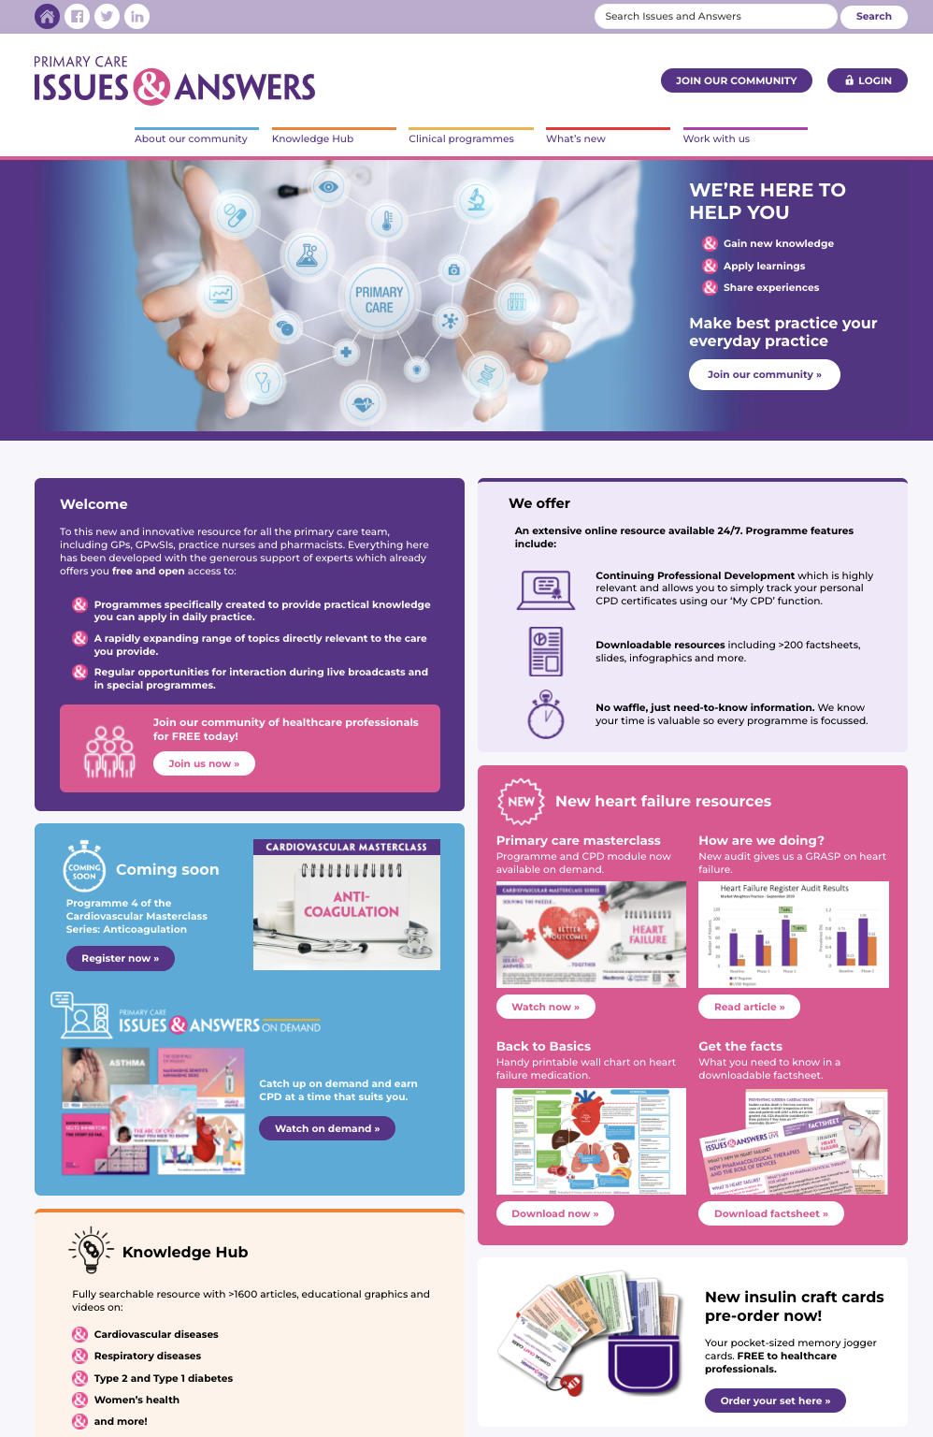

The new unique digital platform for the community of healthcare professionals who care for millions of patients in primary care.
It’s free to join and with the support of experts across this diverse spectrum of diseases and conditions, offers easy access to authoritative knowledge and understanding.

Slide 4


GPs
GPwSIs
Nurses
Pharmacists
Dedicated to making best practice everyday practice

Slide 5


Current hot topics
Expert-led masterclasses
Interactive Q&A with polling
Case studies
All relevant and
actionable learning

Slide 6


Pre-recorded and edited for maximum impact
Blended with
  Practical case-led discussions
  Live interaction
  CPD
  Downloadable materials
Extensive pre-promotion

Slide 7

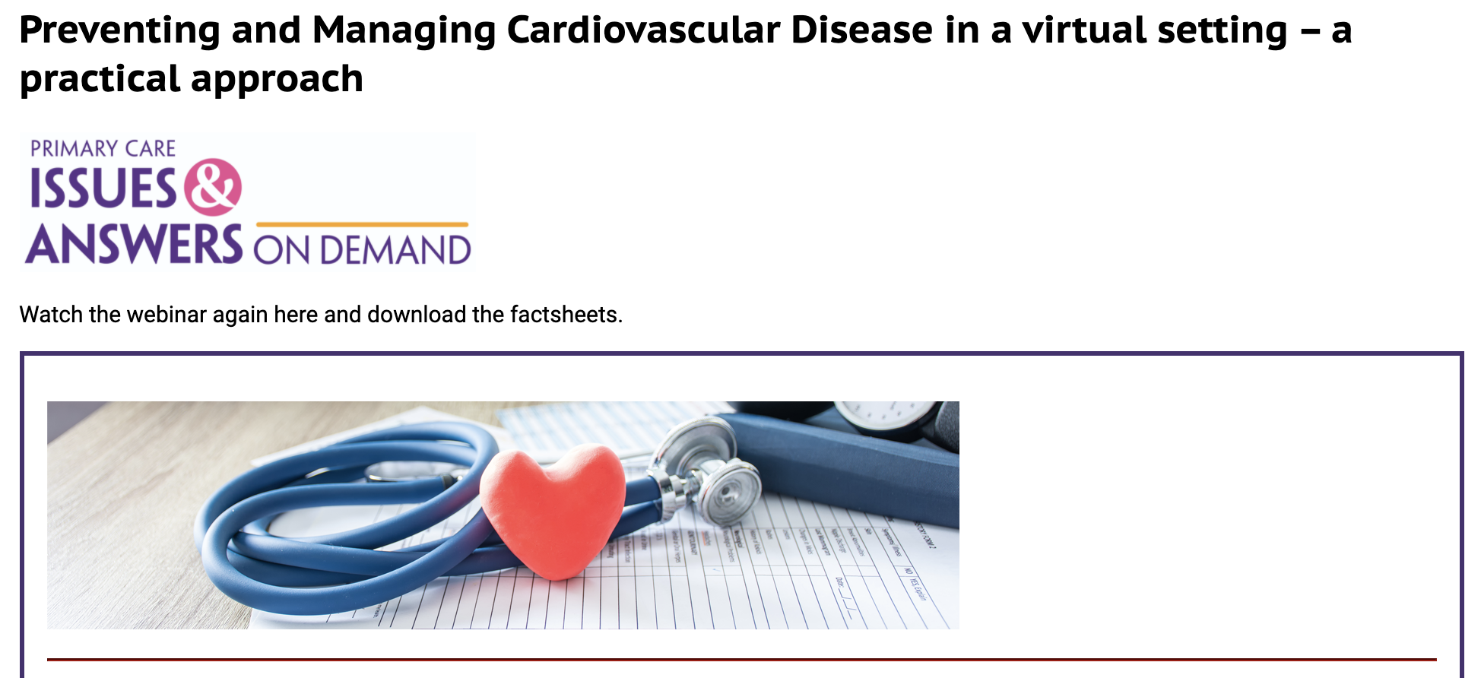









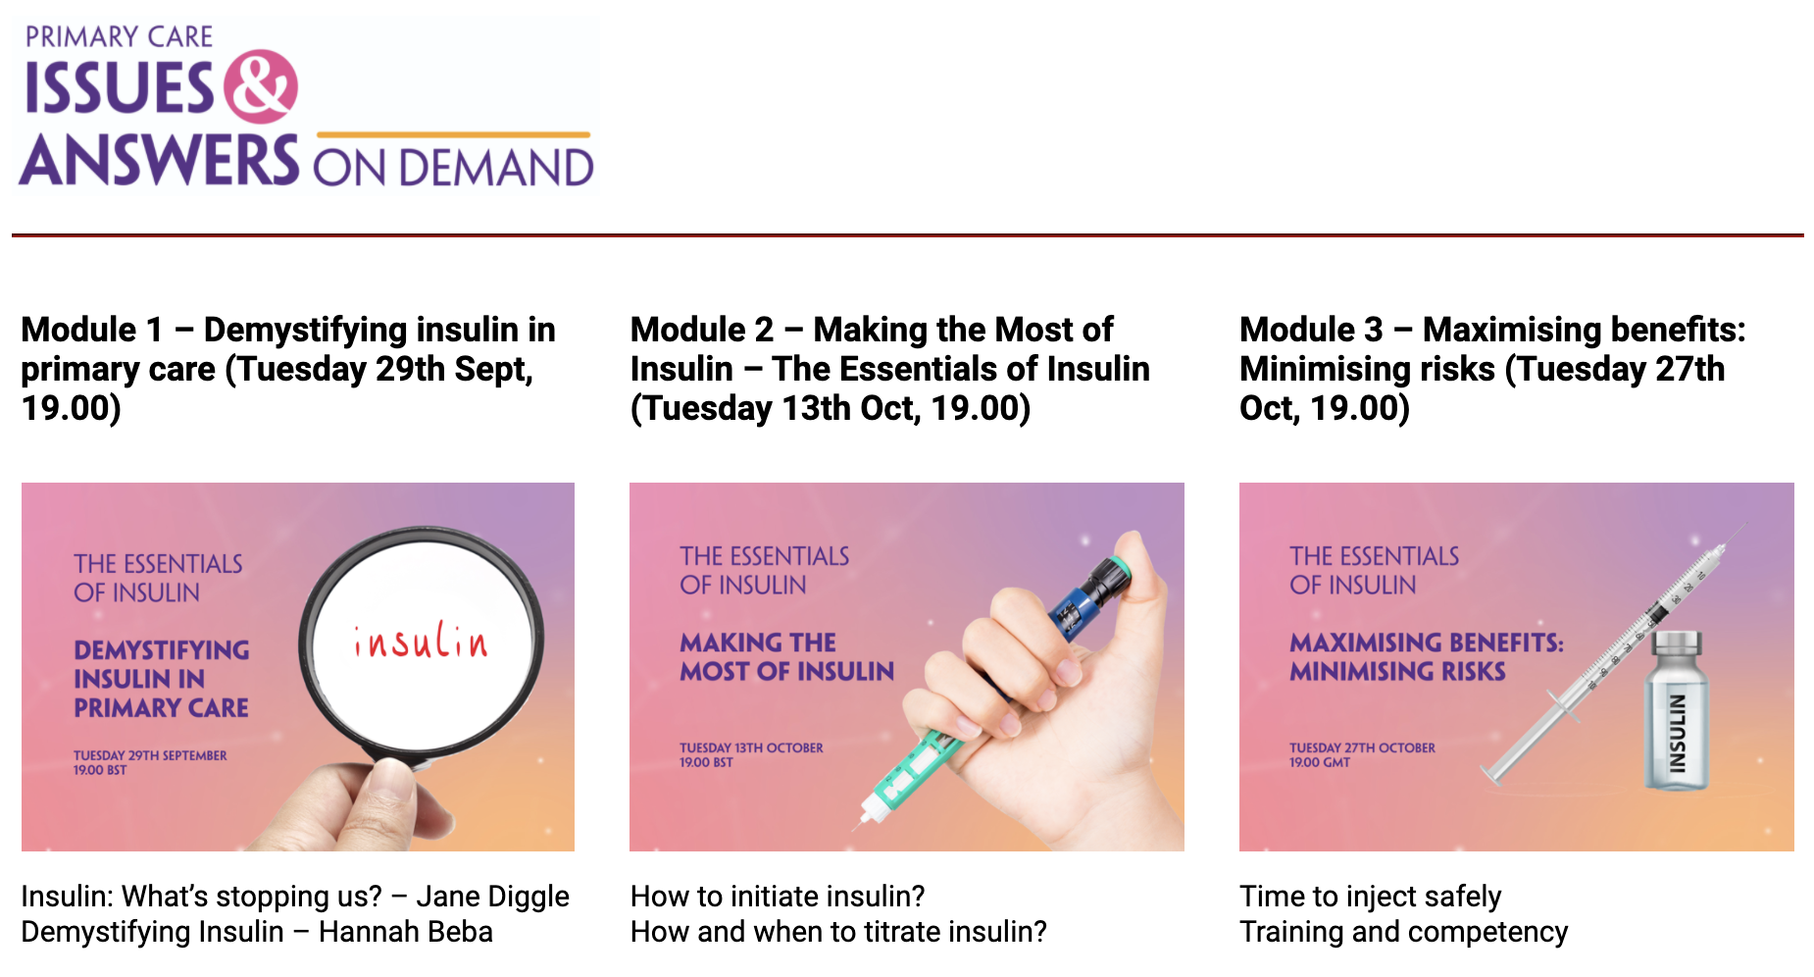
Every live programme on demand 24/7
Available for 12 months
CPD included
Now >60% total views

Slide 8


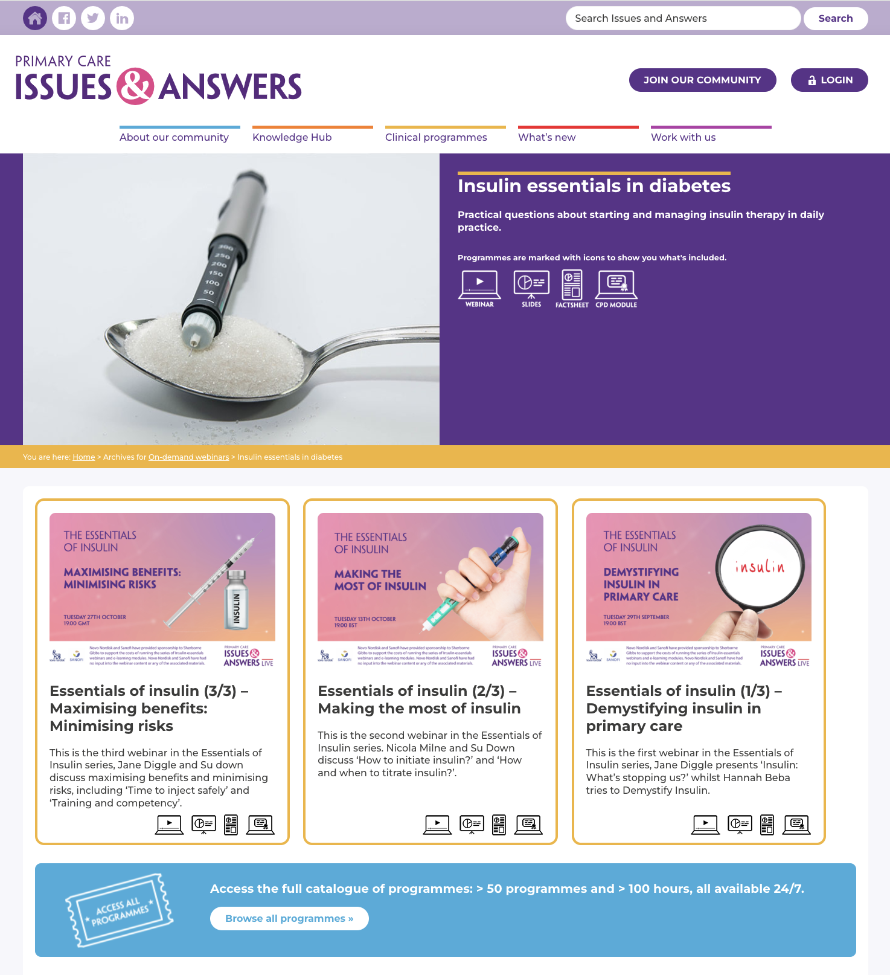
Addressing issues in primary care
Sequential learning
CPD
All available on demand
Follow-up interactive Q&A
Translated into practice
Live case studies applying learnings

Slide 9


Fully searchable Knowledge Hub
Already includes ≥1,600 resources on primary care topics
Collections on hot issues in cardiology, diabetes, respiratory diseases, and more

Slide 10
Hundreds of downloadable materials
Expert articles
Learning programmes with video
CPD modules
All in a single searchable e-platform
<3 minutes to register: www.issuesandaswers.org
Free open-access

Slide 11
















Slide 12

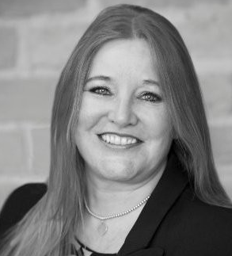
Contact
Jane Boyle
Programme Director
Telephone: 01789 766098
Email: jboyle@sherbornegibbs.co.uk
www.issuesandanswers.org
Minerva Mill Innovation Centre, Station Road, Alcester, Warwickshire, B49 5ET

